Slide 1
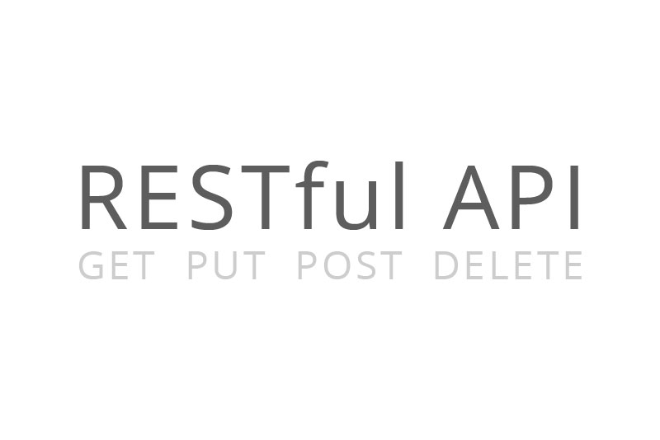
JS Testing In a Nutshell Demo

Slide 2
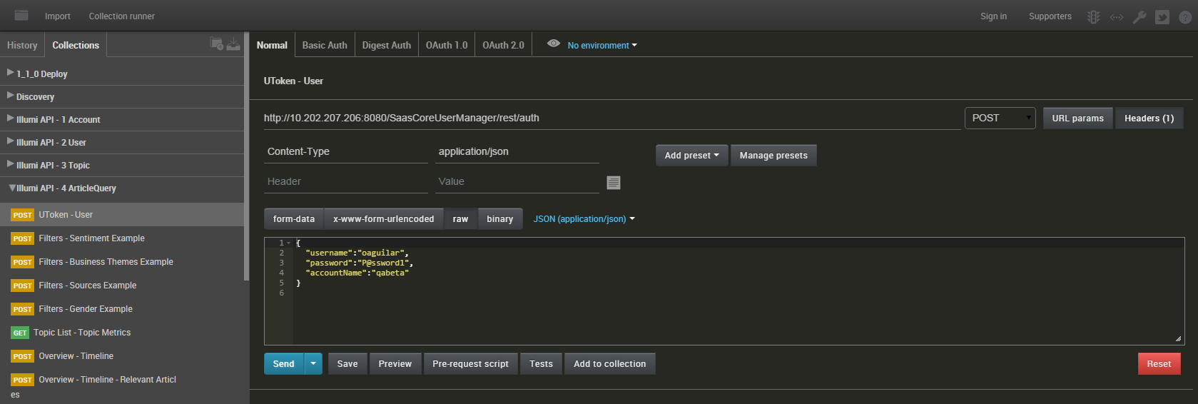
POSTMAN

Slide 3
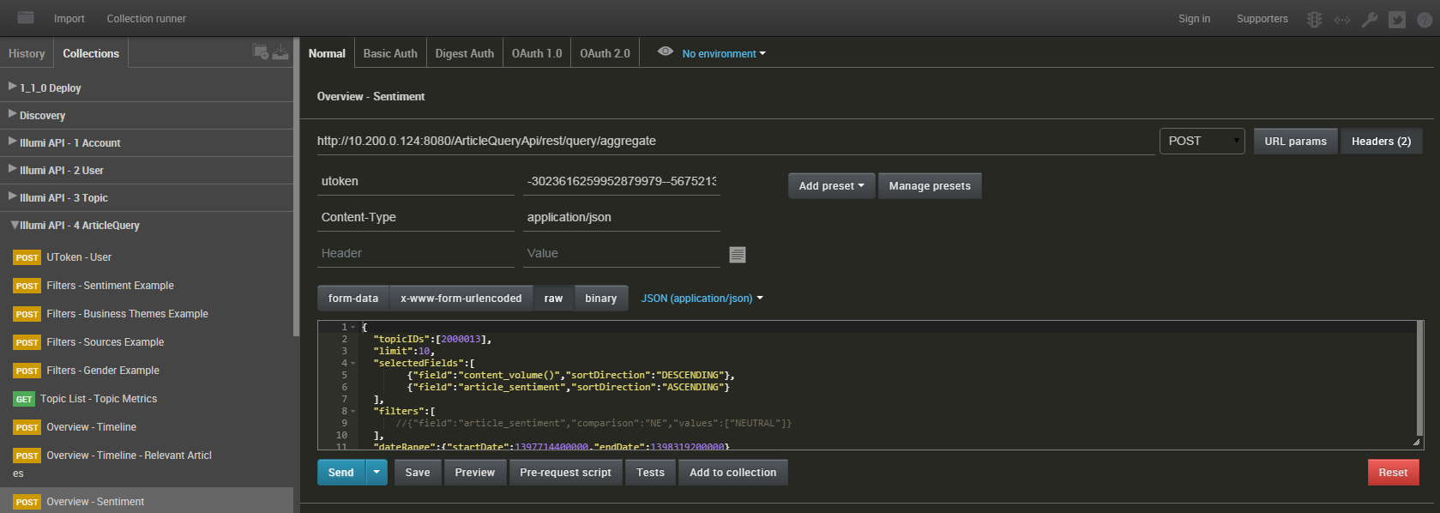
POSTMANual

Slide 4

JavaScript (JS) is a dynamic programming language. It is most commonly used as part of web browsers, whose implementations allow client-side scripts to interact with the user, control the browser, communicate asynchronously, and alter the document content that is displayed. http://www.w3schools.com/js/

Slide 5

Node.js is an open source, cross-platform runtime environment for server-side and networking applications. Node.js applications are written in JavaScript, and can be run within the Node.js runtime on OS X, Microsoft Windows, Linux, FreeBSD, NonStop and IBM i.
Node.js provides an event-driven architecture and a non-blocking I/O API that optimizes an application's throughput and scalability. These technologies are commonly used for real-time web applications. https://nodejs.org/

Slide 6

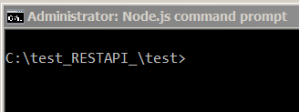
npm is a package manager for JavaScript, and is the default for Node.js. As of Node.js version 0.6.3, npm is bundled and installed automatically with the environment. npm runs through the command line and manages dependencies for an application. It also allows users to install Node.js applications that are available on the npm registry. npm is written entirely in JavaScript. https://www.npmjs.com/

Slide 7

Frisby is a REST API testing framework built on node.js and Jasmine that makes testing API endpoints easy, fast, and fun. Read below for a quick overview, or check out the API documentation. Frisby is built on top of the Jasmine BDD framework, and uses the jasmine-node test runner to run spec tests. http://frisbyjs.com/
Install Frisby
Frisby requires both node.js and NPM to be installed on your system, and is installable as an NPM package.
npm install -g frisby

Slide 8

Jasmine is a Behavior Driven Development testing framework for JavaScript. It does not rely on browsers, DOM, or any JavaScript framework. Thus it's suited for websites, Node.js projects, or anywhere that JavaScript can run. http://jasmine.github.io/
Install jasmine-node
npm install -g jasmine-node

Slide 9
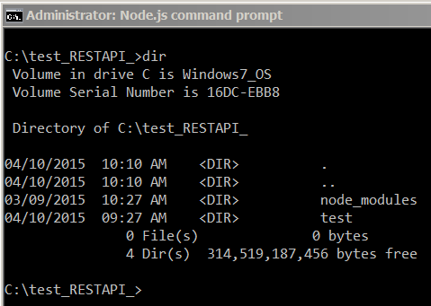
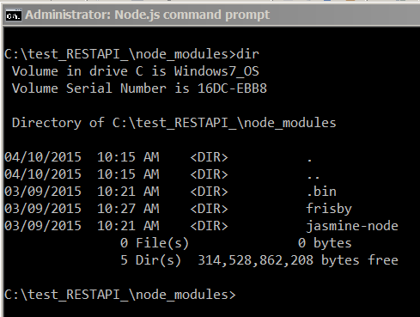
Directory Structure

Slide 10
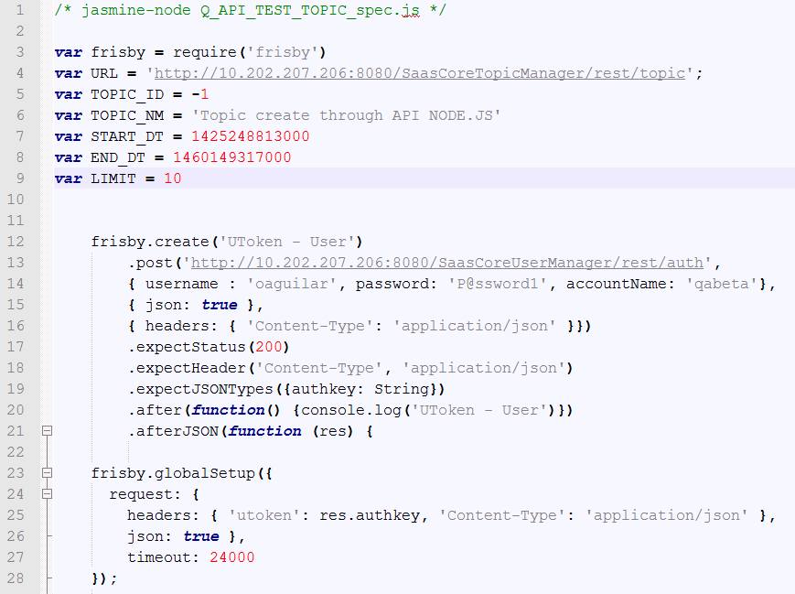
{ The Code }

Slide 11
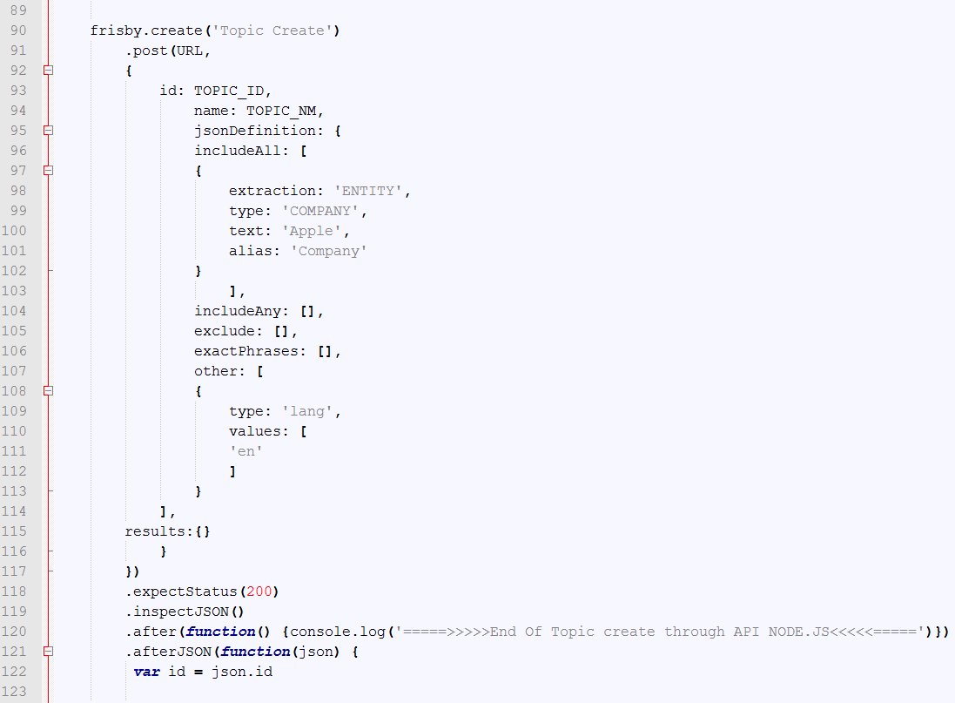
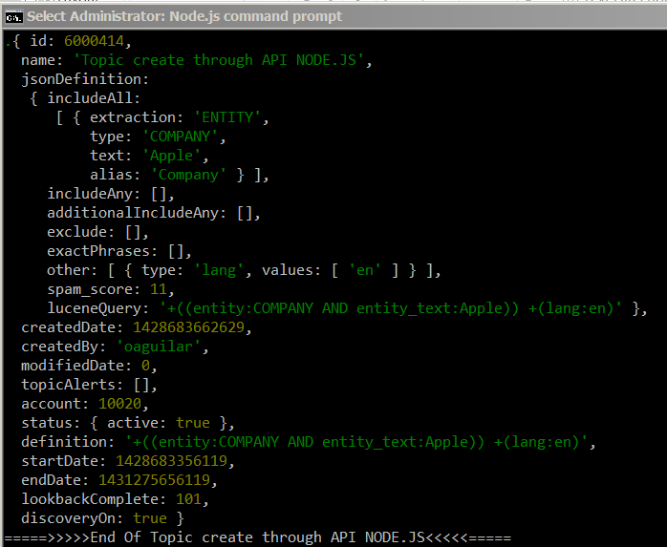
{ More Code }

Slide 12
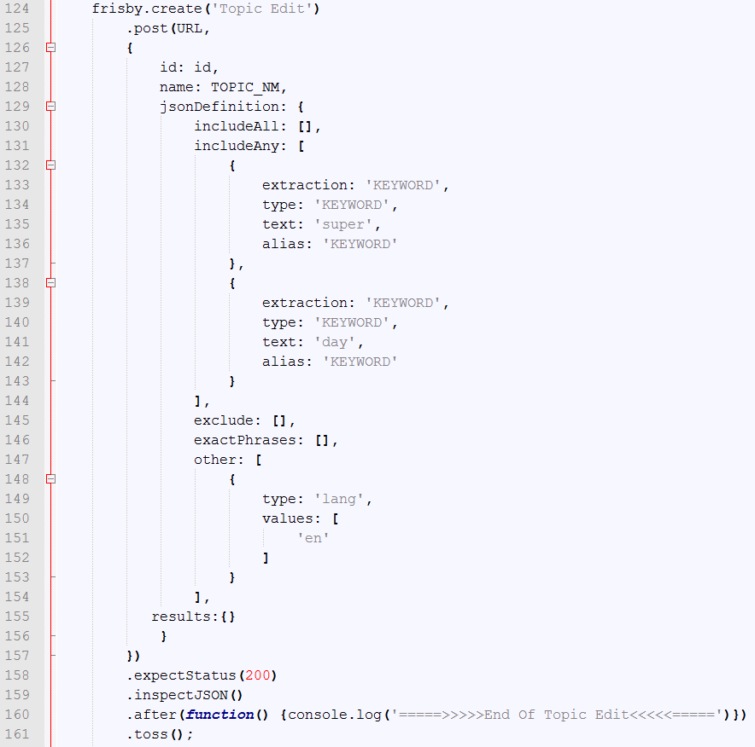
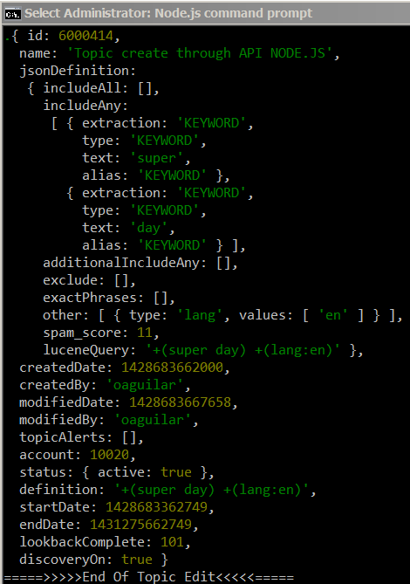
{ More Code (con’t) }

Slide 13
Let Run Our First Test
jasmine-node Q_API_TEST_TOPIC_spec.js

Slide 14
API - Topic
http://10.202.207.206:8080/SaasCoreUserManager/rest/auth
http://10.202.207.206:8080/SaasCoreTopicManager/rest/topic (Topic List)
http://10.202.207.206:8080/SaasCoreTopicManager/rest/topic/unique
http://10.202.207.206:8080/SaasCoreTopicManager/rest/topic/sanity
http://10.202.207.206:8080/SaasCoreTopicManager/rest/topic (Topic Create)
http://10.202.207.206:8080/SaasCoreTopicManager/rest/topic (Topic Edit)
http://10.202.207.206:8080/SaasCoreTopicManager/rest/topic/topicAudit/
http://10.202.207.206:8080/SaasCoreTopicManager/rest/topic (Topic Delete)

Slide 15
Let Run Our Second Test
jasmine-node Q_API_TEST_ARTICLEQUERY_spec.js

Slide 16
API - ARTICLE QUERY
http://10.202.207.206:8080/SaasCoreUserManager/rest/auth
http://10.202.207.206:8080/SaasCoreTopicManager/rest/topic (Topic Create)
http://10.202.207.206:8080/ArticleQueryApi/rest/query/entitysentiment
http://10.202.207.206:8080/ArticleQueryApi/rest/query/topicmetrics
http://10.202.207.206:8080/ArticleQueryApi/rest/query/timeseries
http://10.202.207.206:8080/ArticleQueryApi/rest/query/tsrelevantarticles
http://10.202.207.206:8080/ArticleQueryApi/rest/query/aggregate
http://10.202.207.206:8080/ArticleQueryApi/rest/query/volatility
http://10.202.207.206:8080/ArticleQueryApi/rest/query/trends
http://10.202.207.206:8080/ArticleQueryApi/rest/query/details
http://10.202.207.206:8080/ArticleQueryApi/rest/query/clusters
http://10.202.207.206:8080/ArticleQueryApi/rest/query/fieldsmap
http://10.202.207.206:8080/ArticleQueryApi/rest/query/details

Slide 17

Questions?

